Slide 1
Vendor Cost Comparison and Procurement decision

Slide 2
Problem Statement
The Company Purchase raw materials and Products From multiple vendors
Vendor differ in Pricing, Delivery time, reliability and product Quality
Choosing the right vendors is critical because procurement decisions have a direct impact on overall business costs and profitability
Management aims to reduce procurement costs in order to improve profit margins
Company concerned about whether choosing the lower prised might compromise the Quality and Product standards
Vendor selection decisions are largely based on past relationships, familiarity, or informal experience with suppliers
The company wants to perform a vendor performance and procurement analysis

Slide 3
Final Question
Which vendors consistently offer the most competitive prices?
Which vendors provide better delivery performance?
Are higher-priced vendors actually providing better quality or reliability?
Which vendors offer the best overall value for the company?
Which vendor fulfils the ordered quantity?
Which vendor generates the highest profit?
Which vendor offers the lowest Total Cost of Ownership (TCO)?

Slide 4
Project analysis slide 2
Project Analysis
Cost Comparison
Quality Approval Rate %
PROJECT
Delivery Performance %
Quantity Approval Rate %
Profit Margin%
Total Cost of Ownership

Slide 5
Project analysis slide 3
Project Analysis
DELIVERY ANALYSIS
COST
ANALYSIS
QUALITY
ANALYSIS
I compared the actual delivery date with the promised delivery date to identify on-time and delayed deliveries. Then, I calculated the on-time delivery percentage by dividing the number of on-time deliveries by the total number of deliveries and multiplying the result by 100
.
QUANTITY ANALYSIS
TCO
Profit Margin %
I calculated the Profit Margin Percentage by dividing the total company profit by the total sales amount and multiplying the result by 100
I calculated the Total Cost of Ownership (TCO) by adding the purchase cost, GST, loading and unloading charges, delay cost, defect cost, and transportation cost.
I calculated the average unit price by dividing the total unit price by the total number of orders.
I calculated the Quality Approval Rate by dividing the Quality Approved Quantity by the Received Quantity and multiplying the result by 100
I calculated the Quantity Fulfilment Rate by dividing the Received Quantity by the Order Quantity and multiplying the result by 100

Slide 6
After comparing all vendors, Coromandel Industrial Mart offers the lowest unit price.

Slide 7
National Engineering Stores has the highest on-time delivery percentage among all vendors.

Slide 8
Apex Electrical Materials achieved the highest percentage of quality-approved products.

Slide 9
Coromandel Industrial Mart achieved the highest quantity fulfillment rate among all vendors.

Slide 10
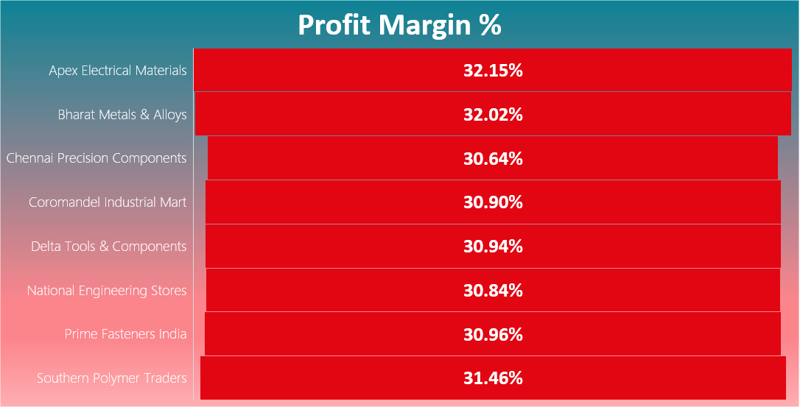
Apex Electrical Materials recorded the highest profit margin among all vendors

Slide 11
Southern Polymer Traders offers the lowest Total Cost of Ownership (TCO) among all vendors.

Slide 12
Weighted Scoring Method
Cost 30%
Quality 25%
Delivery 20%
Quantity 10%
Total Cost of Ownership 15%
I used the Weighted Scoring Method to calculate the final score by combining all evaluation criteria into a single summary. Then, I ranked the vendors based on their final scores.

Slide 13
Final Vendor Ranking
Vendor Name | Cost Score | Delivery Score | Quality Score | Qty Score | TCO Score | Final Score | Rank
Southern Polymer Traders | 96.60 | 95.91 | 99.90 | 99.86 | 100.00 | 98.12 | 1
Coromandel Industrial Mart | 100.00 | 93.59 | 99.96 | 100.00 | 86.27 | 96.65 | 2
Apex Electrical Materials | 98.11 | 95.58 | 100.00 | 99.76 | 84.85 | 96.25 | 3
National Engineering Stores | 95.53 | 100.00 | 99.96 | 99.84 | 81.75 | 95.89 | 4
Prime Fasteners India | 95.11 | 95.51 | 99.95 | 99.78 | 87.18 | 95.68 | 5
Bharat Metals & Alloys | 91.69 | 97.77 | 99.96 | 99.94 | 90.03 | 95.55 | 6
Chennai Precision Components | 92.88 | 98.35 | 99.92 | 99.83 | 82.93 | 94.94 | 7
Delta Tools & Components | 91.14 | 96.26 | 99.95 | 99.94 | 84.61 | 94.27 | 8

Slide 14
Best Vendor Recommendation
Southern Polymer Traders
Final Score – 98.12

Slide 15
Top 3 Vendors
Southern Polymer Traders
Coromandel Industrial Mart
Apex Electrical Materials
The top three vendors are Southern Polymer Traders, Coromandel Industrial Mart, and Apex Electrical Materials. Although Coromandel Industrial Mart and Apex Electrical Materials perform best in two evaluation criteria, Southern Polymer Traders offers the lowest Total Cost of Ownership (TCO). Therefore, based on the overall evaluation, Southern Polymer Traders is recommended as the best vendor.

Slide 16
Why Southern Polymer Traders wins?
Lowest TCO: Offers the lowest Total Cost of Ownership among all vendors.
Cost Advantage: Helps reduce the company's overall procurement costs.
Overall Evaluation: Performs well in the overall vendor evaluation.
Best Vendor Recommendation: Achieves the best overall result based on the weighted scoring method.
Final Decision: Southern Polymer Traders is recommended as the best vendor for cost-effective procurement.

Slide 17
Thank You

